Slide 1
AUTOMATED EVALUATION OF UPPER-LIMB MOTOR FUNCTION IMPAIRMENT USING FUGL-MEYER ASSESSMENT
Seunghee Lee, Yang-Soo Lee, Jonhgyun Kim
Presentation: Mert Karaoğlu

Slide 2
Abstract
Upper extremity motor function analysis in stroke patients
Automation of 79% of Fugl-Meyer Assessment using Kinect v2 and FSR
9 stroke patients
Accuracy of 92%

Slide 3
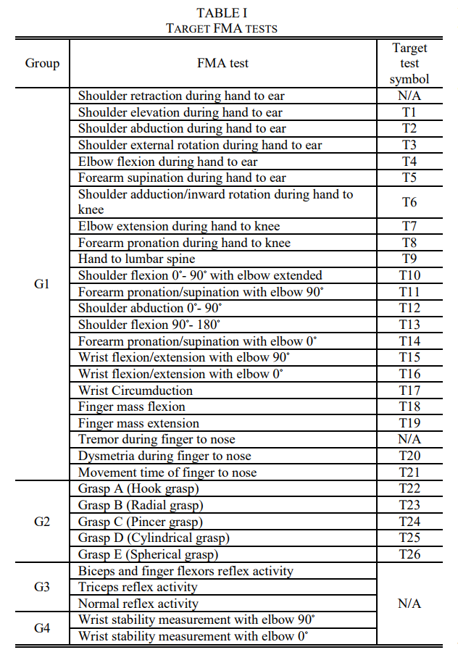
Target FMA Tests and Selected Sensors
The FMA consists of 33 tests for shoulders, elbows, forearms, wrists, hands, and coordination and speed.
These tests are splitted into 4 groups according to their application and evaluation:
The clinician directs the patient to perfom specific motions and observe to evaluate.
The clinician tugs evaluate.
The clinician applies external force to patient’s specific joints for a reflex to evaluate.
The clinician senses the resistance and fine tremors to evaluate.

Slide 4
Target FMA Tests and Selected Sensors
G1 is the most focused group due to it’s richness in number and passive way of evaluation.
G2’s tug evaluation method is replaced by measuring the strength of the grip on the object measured using the FSR.
A test is not applied in G1 due to they are not able to be precisely measured by Kinect v2.

Slide 5
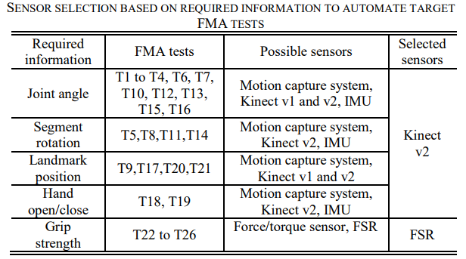

Slide 6
Rule-Based Binary Logic Algorithm
In general FMA tests are evaluated over a 3-point scale:
0: Can NOT be performed at all.
1: Can be performed partly.
2: Can be performed faultlessly.
In the classical FMA a clinician evaluates several key tasks decomposed from a patient’s instructed movement and assigns a score after considering them all.
The features required to evaluate the tasks can be devided into three types:
Fva: Dominant joint movement
Fvb: Evaluate grasp motion
Fm: Maintaining specific posture during movement in two degrees

Slide 7
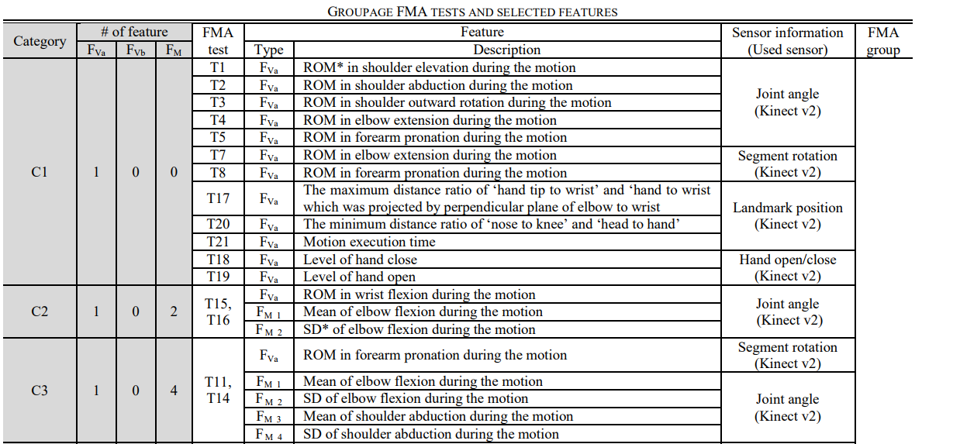

Slide 8
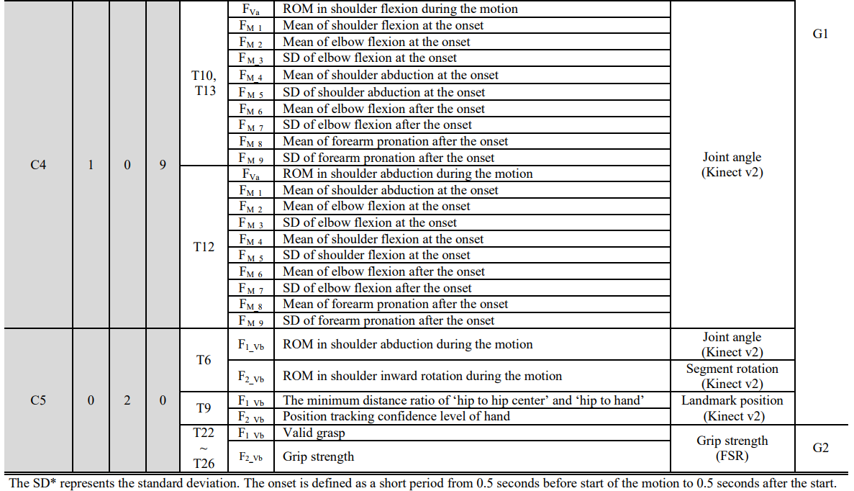

Slide 9
Rule-Based Binary Logic Algorithm
Calculating joint angles and segmentation rotation requires pre-processing of the raw data collected by Kinect v2.
Other types of evaluations are directly calculated by Kinect v2 SDK.
Joint angles are calculated using their target landmark and their proximal / distal landmark positions.
As the SDK provides a quartenation (w + xi + yj + zk) form of segment rotation. (Which can be easily converted to degrees.)
Based on joint angles and segment rotation: ROM, motion execution time and mean / SD can be calculated.
Kinect v2’s hand grasp information was only used when the high confidence level was provided by the SDK.

Slide 10
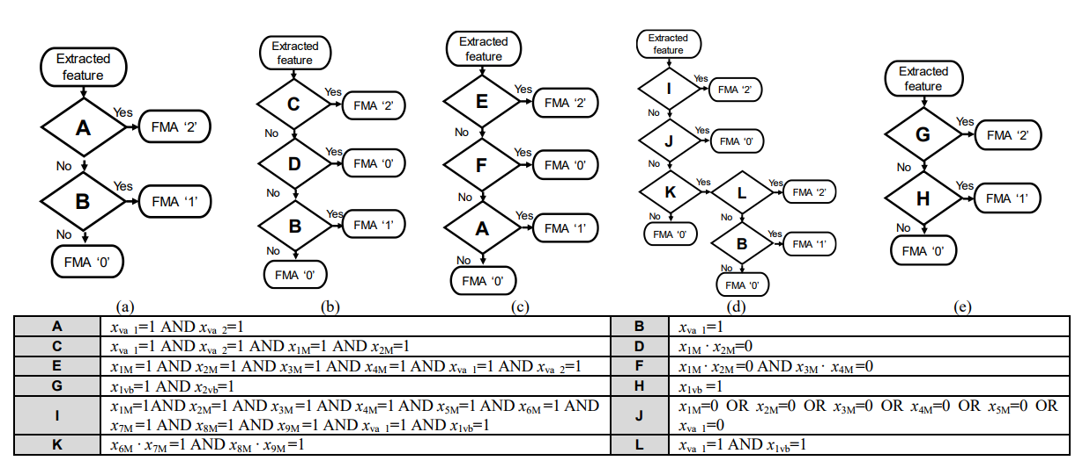
Rule-Based Binary Logic Algorithm
Linguistic guideline is converted into binary logics and a classification algorithm to assign FMA scores is implemented.

Slide 11

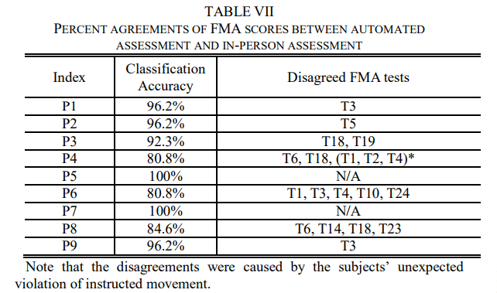
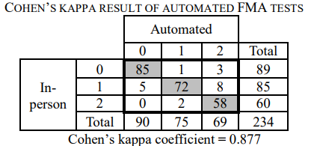
Results
The average percent agreement is approximately 92%.
To evaluate the scoring accuracy, Cohhen’s kappa coefficient (k) as k = 0.877.

Slide 12

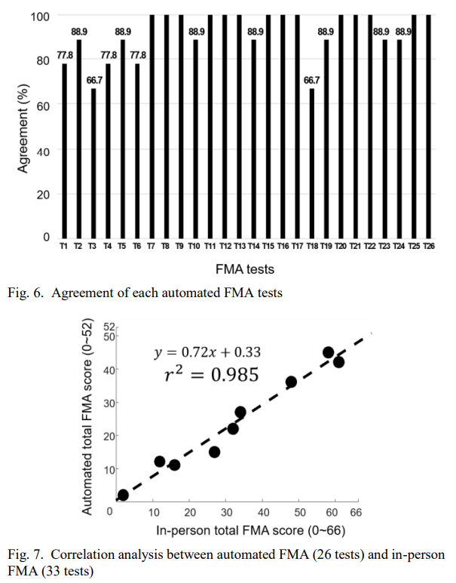
Results
Percentage of agreemtn for each FMA test is calculated.
A correlation analysis for 26 automated and 33 in-person FMA tests is made.

Slide 13
Discussion
The average accuracy of the automated FMA is very high.
Few tests exhibited disagreement due to:
The low thumb tracking accuracy of Kinect v2 (forearm pronation and spunation)
Binary logic algorithm’s inbalanced threshold and inconsistent evaluation of clinicians tug tests
Wearing tight clothes can reduce error in shoulder rotation evaluations
A promising future clinical method

